Slide 1
BT201
Biochemical Process Calculations
14/09/2022

Slide 2
Problem 1 -1
In the process for the manufacture of chlorine, HCl and O₂ react to form Cl and H₂O. Sufficient air (21 mole% O₂ , 79% N₂ ) is fed to provide 35% excess oxygen and the fractional conversion of HCl is 85%.
Calculate the mole fractions of the product stream components, using atomic species balances in your calculation.
Again calculate the mole fractions of the product stream components, only this time use the extent of reaction in the calculation.

Slide 3
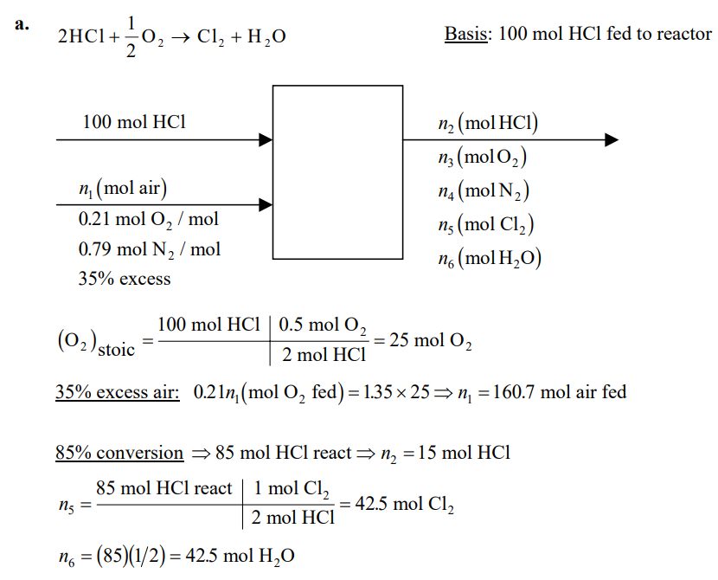
Rate of accumulation=rate of input +rate of generation- rate of output –rate of consumption

Slide 4
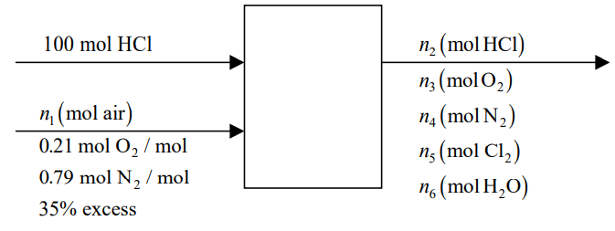
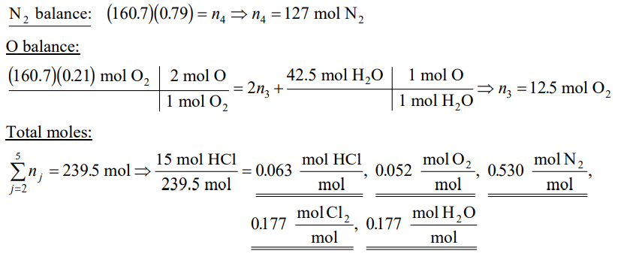

Slide 5
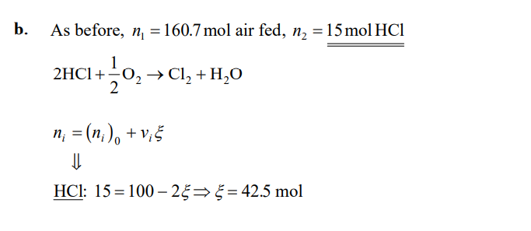
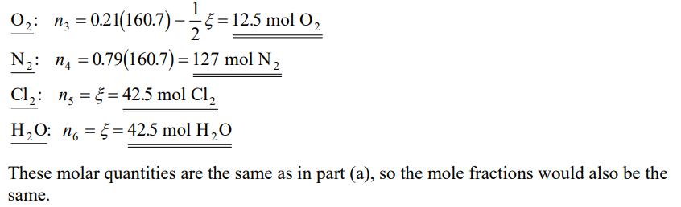

Slide 6
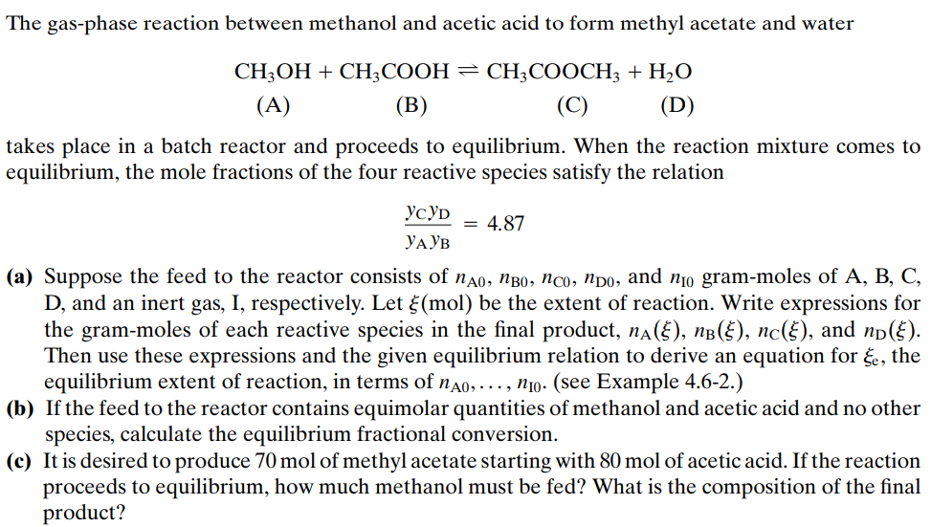
Problem -2

Slide 7
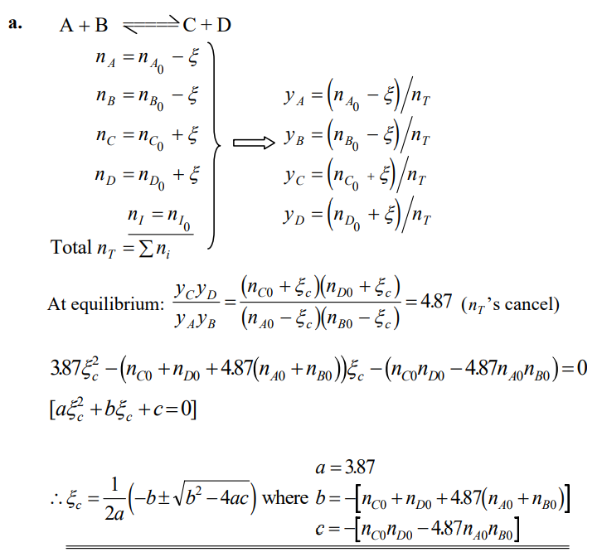


Slide 8
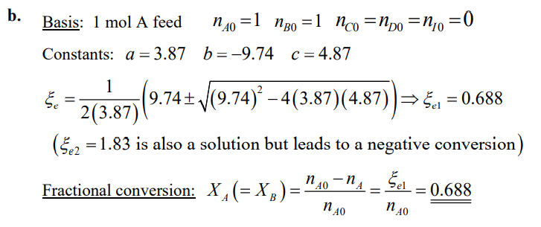

Slide 9
